Slide 1
OVERVIEW OF COMPUTER SYSTEMS
PROGRAMMING LANGUAGES
CSC 130 – Scientific Programming
Unit 1 – Overview of Computer Systems –
Hardware and Software

Slide 2
LEARNING OBJECTIVES
LO1.1. – List computer operations
LO1.2. – Classify computer components
LO1.3. – Illustrate the computer structure
LO1.4. – Define types of software
LO 1.5. – Classify software programs
LO 1.6. – Discuss use of computers
LO 1.7. – Examine types of applications
LO 1.8. – Discuss use of computers
LO 1.8. – Evaluate hardware and software components in today’s computers
LO 1.10. – Design an ideal computer configuration
CSC 130 – Scientific Programming

Slide 3

PROGRAMMING LANGUAGE
A programming language represent a vocabulary and collection of grammatical rules for instructing a computer to perform specific tasks
Java
C++
LISP
High-level Languages
Assembly Language
Machine Language
Hardware
CSC 130 – Scientific Programming

Slide 4
COMPILER VS INTERPRETER
All programs written in high-level programming language has to be translated in machine language using:
  Compiler – translates the entire source program indicating all the syntax errors, and, if the program is error free, executes the result program in machine language
  Interpreter – translates and executes portions of the source code at a time
Each programming language has a specific compiler or interpreter
The object code is specific to a certain processor
CSC 130 – Scientific Programming

Slide 5
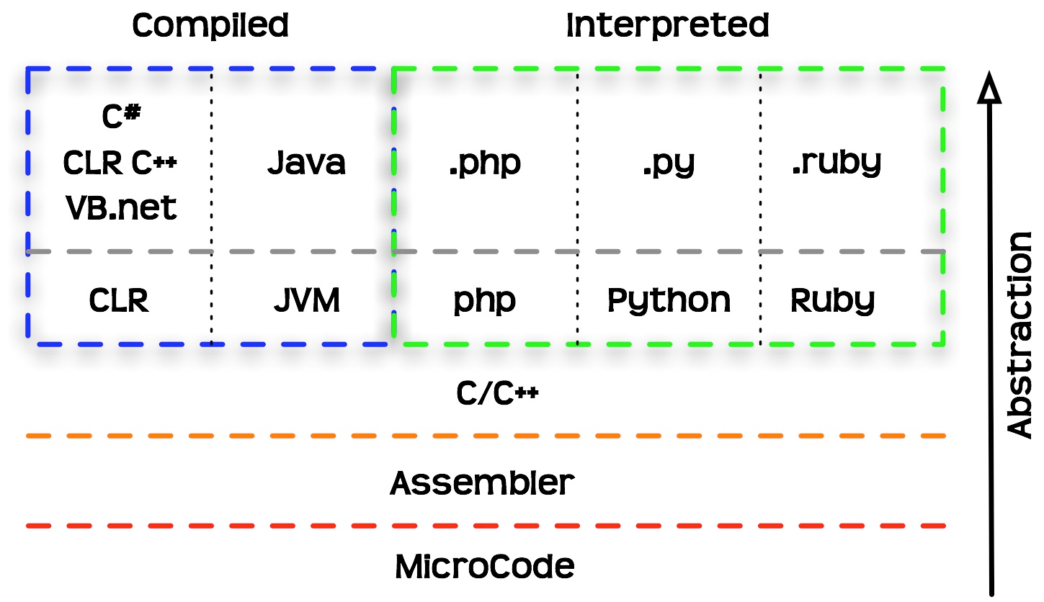
COMPILER VS INTERPRETER
CSC 130 – Scientific Programming

Slide 6
JAVA BYTECODE
The Java compiler does not translate a Java program into assembly language or machine language for a particular computer.
Instead, it translates a Java program into byte-code - the machine language for a hypothetical computer (or interpreter) called the Java Virtual Machine.
A byte-code program is easy to translate into machine language for any particular computer.
A program called an interpreter translates each byte-code instruction, executing the resulting machine-language instructions on the particular computer before translating the next byte-code instruction.
CSC 130 – Scientific Programming

Slide 7
COMPILE – INTERPRET - RUN
Use the compiler to translate the Java program into byte-code (done using the javac command).
Use the Java virtual machine for your computer to translate each byte-code instruction into machine language and to run the resulting machine-language instructions (done using the java command).
After compiling a Java program into byte-code, that byte-code can be used on any computer with a byte-code interpreter and without a need to recompile.
Byte-code can be sent over the Internet and used anywhere in the world.
CSC 130 – Scientific Programming

Slide 8
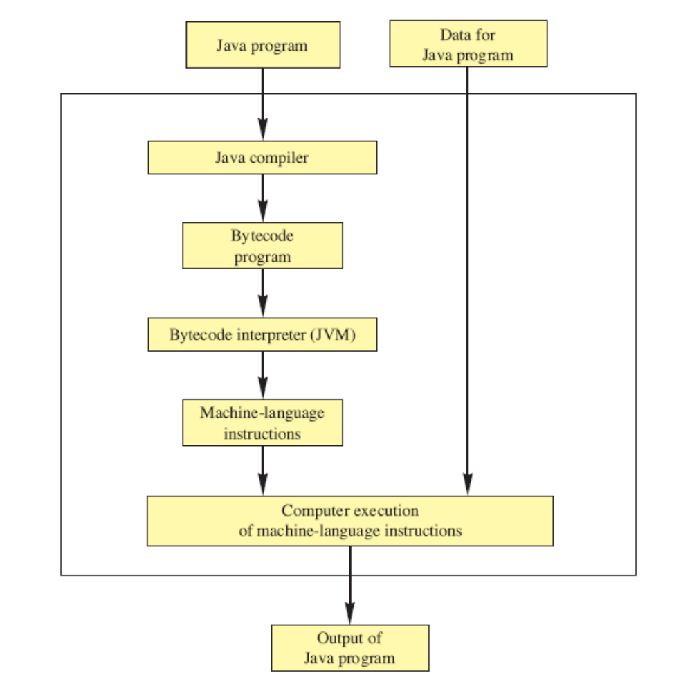
COMPILING AND RUNNING A PROGRAM
CSC 130 – Scientific Programming

